Slide 1

Cloud tech excellence Team Project
Team 1
Shanmugasundaram (Shan) Thirunavukkarasu
David Skarbrevik
Joe Begala
Greg Sylvain
29 October 2020

Slide 2
agenda
Project overview
Tools/Software Environment Used
CI/CD Pipeline design
Twitter Application Workflow
Challenges / Lessons Learned / Successes and Failures
Future Implementation ideas
Demo
Questions

Slide 3
Project overview
Description of project and intent
Our project uses AWS resources and Twitter's Streaming API to allow for real time reporting of public reactions and events.
Project business value
Tracking key metrics on a wide variety of desired topics can allow for actionable insight on those topics.
Technical objectives
Stream Twitter data based on desired topics
Store data and process into meaningful metrics
Display metrics for a user
Automate as much of the deployment of our technical solution as possible
Notes:
GREG-30-45 sec
1:00

Slide 4
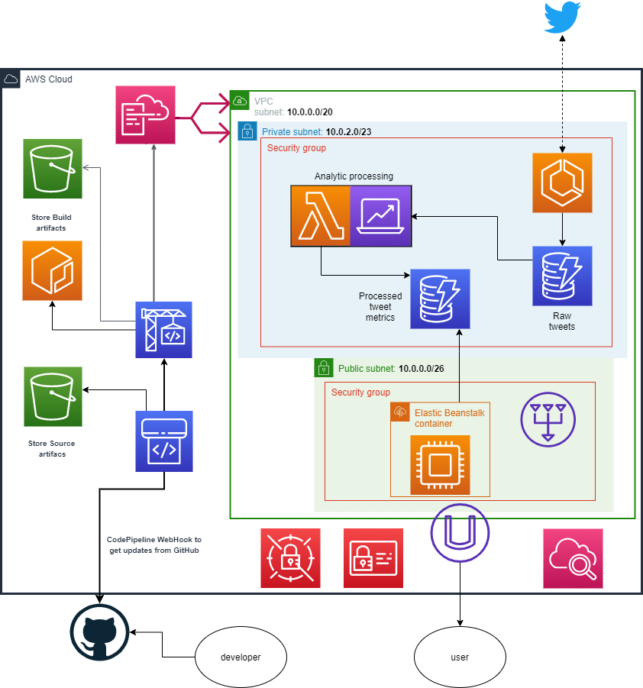
Tools/Software Environment Used
Software Environment Used
GitHub
AWS CodePipeline
List of General Tools Used
Docker
Twitter API
AWS Specific Services Used
Code Pipeline
CloudFormation
ECS & ECR
Elastic Beanstalk
DynamoDB
Lambda
Notes:
SHAN-2 min
3:00
Just an overview to see the stack.
Design decision points:
ECS vs EKS
Github - provides distributed version control and source code management (SCM) functionality of Git, plus its own features. AWS CodePipeline - AWS CodePipeline is a fully managed continuous delivery service that helps you automate your release pipelines for fast and reliable application updates. CodePipeline automates the build, test, and deploy phases of your release process every time there is a code change, based on the release model you define. This enables you to rapidly and reliably deliver features and updates. You can easily integrate AWS CodePipeline with third-party services such as GitHub or with your own custom plugin. We are using GitHub and whenever there are commits to GitHub, CodePipeline will pull the code from GitHub and proceed with necessary steps to deploy the software. Docker - is a platform for developers to develop, build (package and containerize) and ship applications. Software code, dependencies/libraries are built as containers so that wherever deployed will function without issues. Twitter Scraper API - A simple script to scrape for Tweets using Python wrapper that performs API requests such as searching for a keyword and download corresponding tweets. Streaming API, vice a REST API. More of an ongoing stream and we are filtering that stream for specific key words. CloudFormation - Infrastructure as code. CF template program/code your AWS resources and third-party resources and dependencies, provision them quickly as a stack and consistently, and manage them. It will also rollback if there is failure on any one part. We used it to provision our VPC, subnets/AZ, Elastic Beanstalk, instances, dynamodb etc. ECS & ECR - ECS (Elastic Container Service) used to run docker applications. Elastic Container Registry (ECR) is a fully-managed Docker container registry that makes it easy for developers to store, manage, and deploy Docker container images. Amazon ECR is integrated with Amazon Elastic Container Service (ECS), simplifying your development to production workflow. Elastic Beanstalk - is an easy-to-use service for deploying and scaling web applications and services developed with Java, .NET, PHP, Node.js, Python, Ruby, Go, and Docker on familiar servers such as Apache, Nginx, Passenger, and IIS. You can simply upload your code and Elastic Beanstalk automatically handles the deployment, from capacity provisioning, load balancing, auto-scaling to application health monitoring. In our case we provided Python code and it deployed web application DynamoDB - Amazon NoSQL database and it is scalable. We are storing our collected data in here and it also serves the webapplication requests Lambda - serverless. You can run code without provisioning/managing servers and we are using it to execute our Python code.
*********************
Process description w/ arch
Overall Project Architecture
CI/CD workflow kicked off by a GitHub Check-in
Resulting in
Docker image built and pushed to ECR
Deployment of updates to arch
ECS pulls latest Docker image pulled from ECR for grabbing latest Twitter feeds
All activity is logged to CloudWatch

Slide 5
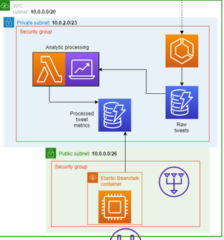
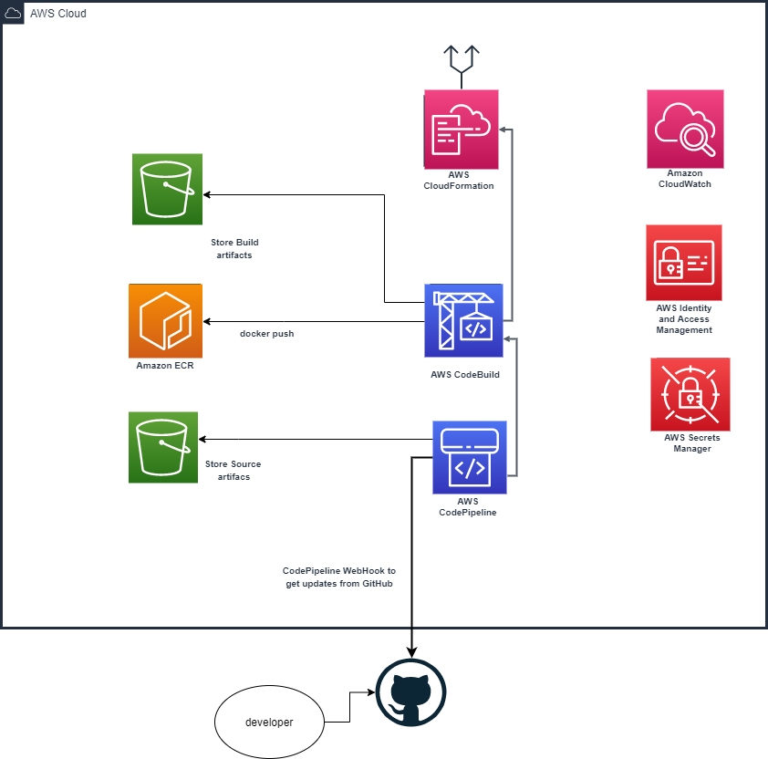
CI/CD Pipeline design
CI/CD Pipeline begins with a GitHub Check-in
AWS CodePipeline is watching GitHub by a WebHook
CodePipeline performs the following:
Source step to pull latest updates from repo and store in S3 bucket
Builld step using CodeBuild to kick off build of Twitter scraper Docker image and push that image to ECR
Deploy step uses CloudFormation to push latest deployment updates to a Nested Stack architecture
A final Deploy step to push latest web application code to Elastic Beanstalk
Notes:
GREG-1 min
4:00
Split this slide up
1-slide CI/CD part
1-slide for the application

Slide 6
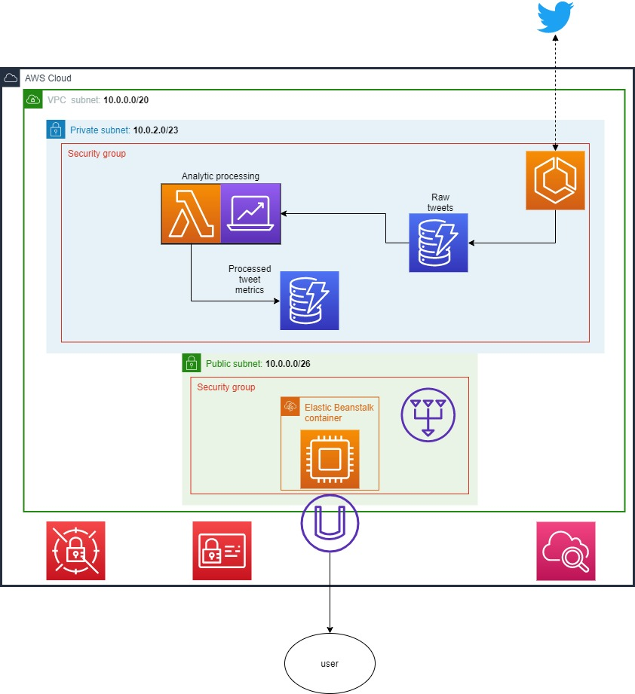
Twitter Application Workflow
ECS container runs a twitter scraper configured with a list of desired topics/terms
ECS container streams unprocessed tweets into raw_tweets DynamoDB Table
A Lambda function is triggered as data enters the raw_tweets table to perform sentiment analysis
Lambda results are stored in tweet_metrics DynamoDB Table
Web application in Elastic Beanstalk pulls data from tweet_metrics table to display to users
Notes:
DAVID-1 min
5:00

Slide 7
Challenges / Lessons learned / successes and failures
Challenges
Designing the CF stack / Working with Nested CloudFormation Templates
Evaluating and selecting software platforms
Trying to consider how to automate secrets management
Deploying applications on Elastic Beanstalk
Threading the needle by rate limiting the Twitter stream to show meaningful data without blowing up our AWS bill
Lessons Learned / Successes and Failures
Automated the deployment of most of our tech stack using CloudFormation
Security: Kicked out of AWS for a day
Unable to deploy with success to Ohio, but other regions worked as expected
Failed CloudFormation Automations:
AWS Secrets Manager
Elastic Beanstalk
Notes:
JOE-1 min
6:00
Challenges
Designing the CF stack / Working with Nested CloudFormation Templates
Trying to consider how to automate secrets management
Deploying applications on Elastic Beanstalk
Lessons Learned / Successes and Failures
Automated the deployment of most of our tech stack using CloudFormation
Security: Kicked out of AWS for a day
Failed CloudFormation Automations:
AWS Secrets Manager
Elastic Beanstalk
Designing the stack / Working with Nested CloudFormation Templates
Decided to employ Nested CloudFormation Stacks to design and deploy critical infrastructure. This allowed for a separation of concerns and division of labor on the component stacks
Evaluating and selecting software platforms
Variety of CI/CD platforms available, settled on using AWS CodePipeline to maximize use of AWS native tools optimized to work with AWS resources
Working with Secrets Manager
Identified Secrets Manager as a good solution to store Twitter API keys
Encountered difficulty integrating into the CloudFormation templates, left as a non-automated feature
Consider using Vault by HashiCorp
Deploying applications on Elastic Beanstalk
Decided to utilize Elastic Beanstalk deployed using CodePipeline to manage the interface
Had difficulty fully automating deployment via CloudFormation so left his as a manual step

Slide 8
Future Implementation ideas
Automation improvements
Incorporate analytics lambda functions and lambda layers into additional CF stacks
Add a Lambda function as a post-deploy step to signal ECS container restart instance or rollover to a new instance with updated ECR image
Dashboard and application improvements
Continue to refine capabilities/metrics based on a specific audience
Data Analyst: allow user to enter their own keywords to watch
Product Manager: metrics to track the success of a new product launch
Utilize other analysis methods
UI/UX enhancements
Scalability and durability improvements
Consider Kinesis to allow for large volume, velocity, and variety of data sources
Multi-AZ deployment & ALB
Notes:
JOE-30-45 sec
6:30
Automation improvements: fully maximize tech stack deployment via CloudFormation
Dashboard refinements: enhance the analytical capabilities and expand roles for the end user
Scalability and durability improvements: leverage AWS Kinesis to be able to ingest much larger data streams

Slide 9
Demonstration
Notes:
DAVID-3.5 min
Send out link to Dashboard app
Check out Team 1’s user facing dashboard here:
http://team1webportal-env.eba-hevpi5u8.us-east-1.elasticbeanstalk.com/

Slide 10
References
Link to GitHub Repo: https://github.com/dskarbrevik/CE-group-project
Link to Dashboard Repo: https://github.com/dskarbrevik/CE-group-project-dashboard

Slide 11
Questions?

